Slide 1

ONLINE BOOK SHOP

Slide 2

UNIVERSITY INSTITUTE OF TECHNOLOGY RGPV Bhopal, M.P.
Guided By: Presented By:
Mr. Dheeresh Chandra Ritu Sahu
kushwaha

Slide 3
ABSTRACT
This software helps customer to find different books according category , price , subcategory , author etc. It is designed such a way that one can view all the updates of the products from any place through online. The software will help in easy maintaining and updating products in the website for the administrator. Also quick and easy comparison of different products for the customers.

Slide 4
MODULES
Registration module
Administrative module
Customer module

Slide 5
1. Registration module
In registration module first we ask customer to give his details. After registering with us the customer can logon to his/her own account and can view all book details such as category , price , author etc. and can order the book with unique book id. Once customer registered with us can order any number of books.

Slide 6
2. Administrative module
Administrative module is provided for the sake of administrators to manage the site and update the content at regular intervals, The major operations included in this module are:
Create and maintain book categories.
View the books available.
Update books information.
Remove the books.
View Customer information and Book Ordering.

Slide 7
3. Customer module
This module is meant for customers, where a user logging into his/her owns account will view this panel. The major operations included in this module were
View all available books and its price , description and other details etc.
Booking for the books.
View and cancelling of the book ordering.
Send feedback

Slide 8
PURPOSE
To manage the online book shopping. It helps to customer to order product from anywhere and anytime. Also make payment on delivery. It helps to people to order desired book at their prefer time.

Slide 9
SCOPE
The project has a wide scope, as it is not intended to a particular organization. This project is going to develop generic software, which can be applied by any businesses organization. More over it provides facility to its customer. Also the software is going to provide a huge amount of summary data.

Slide 10
PROPOSED SYSTEM:
The Proposed system ensures the complete freedom for users, where user at his own system can logon to this website and can order book. Our proposed system allows only registered users to order the product, view booking and cancel their booking as per their need.
In this Proposal the entire work is done on online and book with id is also provided for customer as a print document. Here customer can send their queries and suggestions through a feedback form.

Slide 11
SYSTEM DESIGN
Unified Modeling Language:
UML stands for Unified Modeling Language. It is a third generation method for specifying, visualizing and documenting the artifacts of an object oriented system under development. Object modeling is the process by which the logical objects in the real world (problem space) are represented (mapped) by the actual objects in the program (logical or a mini world). This visual representation of the objects, their relationships and their structures is for the ease of understanding. This is a step while developing any product after analysis.

Slide 12
The Unified Modeling Language encompasses a number of models.
Use case diagrams
Class diagrams
Sequence diagrams

Slide 13
Use Case Diagram:
Use case diagram consists of use cases and actors and shows the interaction between them. The key points are:
The main purpose is to show the interaction between the use cases and the actor.
To represent the system requirement from user’s perspective.
The use cases are the functions that are to be performed in the module.
An actor could be the end-user of the system or an external system.

Slide 14
Manage Product
Manage Feedback
Manage Booking
Manage Users
Use Case Diagram between ADMIN and SYSTEM:

Slide 15
Booking
Cancel
Search
Feedback
Use Case Diagram between USER and SYSTEM:

Slide 16
Sequence Diagram:
The purpose of sequence diagram is to show the flow of functionality through a use case. In other words, we call it a mapping process in terms of data transfers from the actor through the corresponding objects.

Slide 17
SEQUENCE DIAGRAM

Slide 18
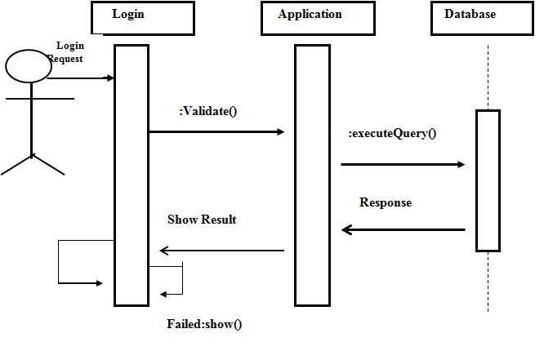
Sequence Diagram For Administrator:-

Slide 19
CLASS DIAGRAM

Slide 20
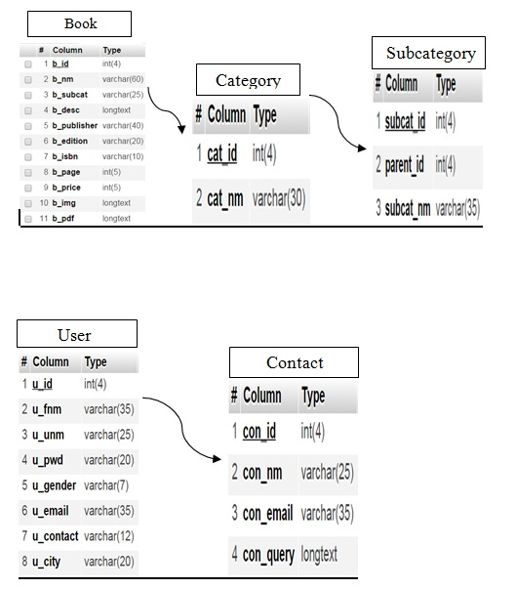

Slide 21
ER DIAGRAM

Slide 22
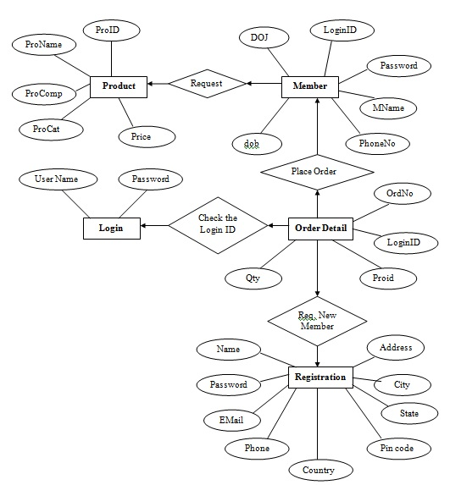

Slide 23
DFD – DATA FLOW DIAGRAM

Slide 24
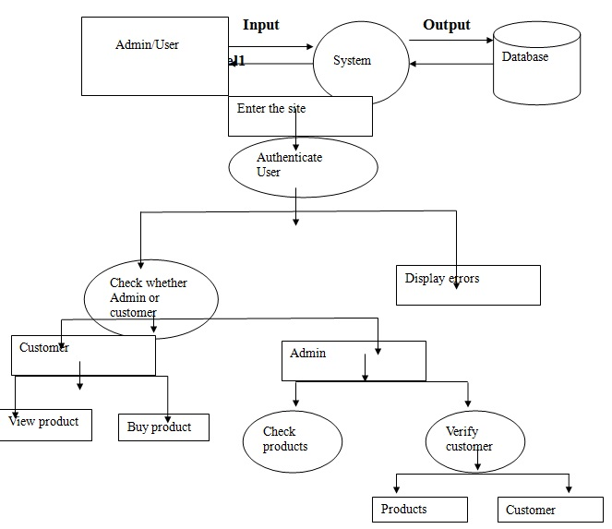

Slide 25
FRONTEND (LANGUAGE USED)
HTML(Hypertext Markup Language)
CSS(Cascading Stylesheet)
JAVASCRIPT
BOOTSTRAP(Framework of CSS and Javascript)

Slide 26

BACKEND
PYTHON DJANGO
SQLITE (DATABASE)

Slide 27
SOFTWARE USED
PYTHON INTERPRETER
PYCHARM IDE (INTEGRATED DEVELOPMENT ENVIRONMENT)
NOTEPAD++ OR ANY OTHER TEXT EDITOR
CHROME OR ANY OTHER BROWSER

Slide 28
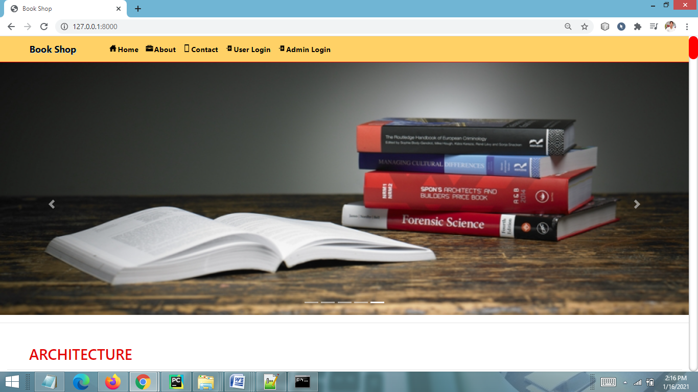
SCREEN SHOTS Home Page

Slide 29
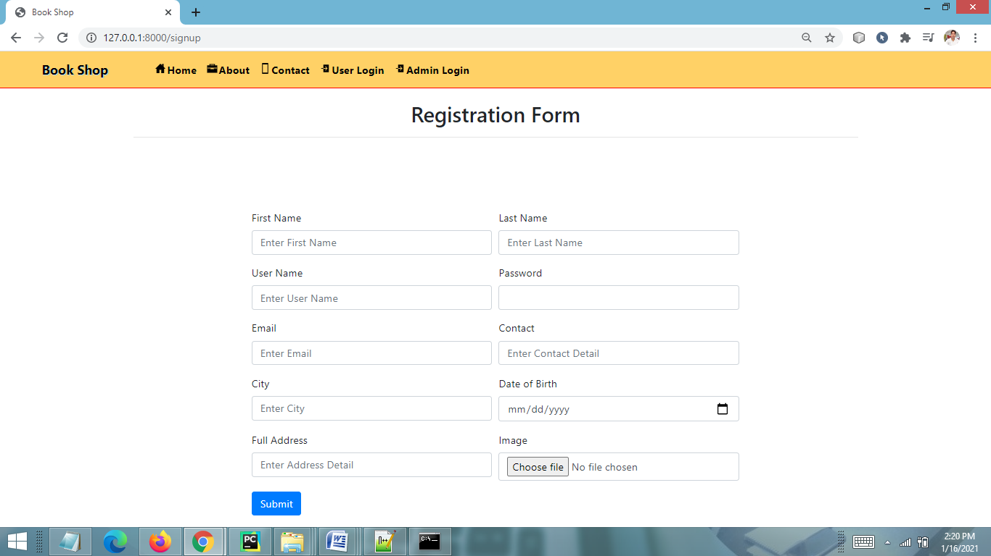
CUSTOMER REGISTRATION FORM

Slide 30
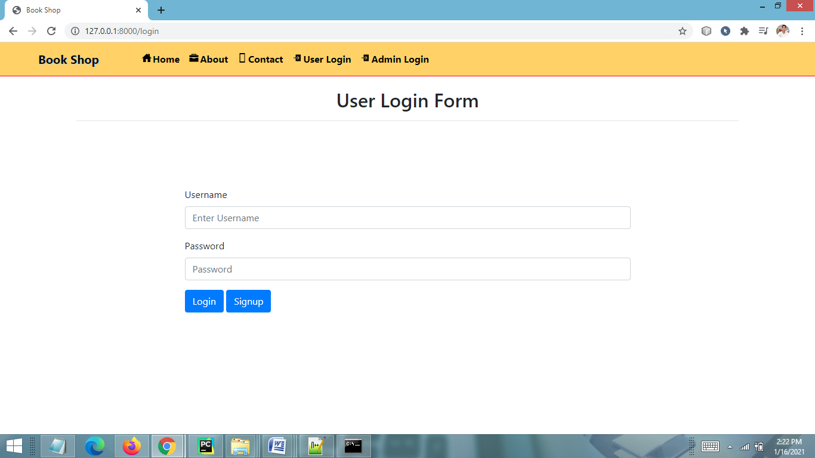
USER LOGIN FORM

Slide 31
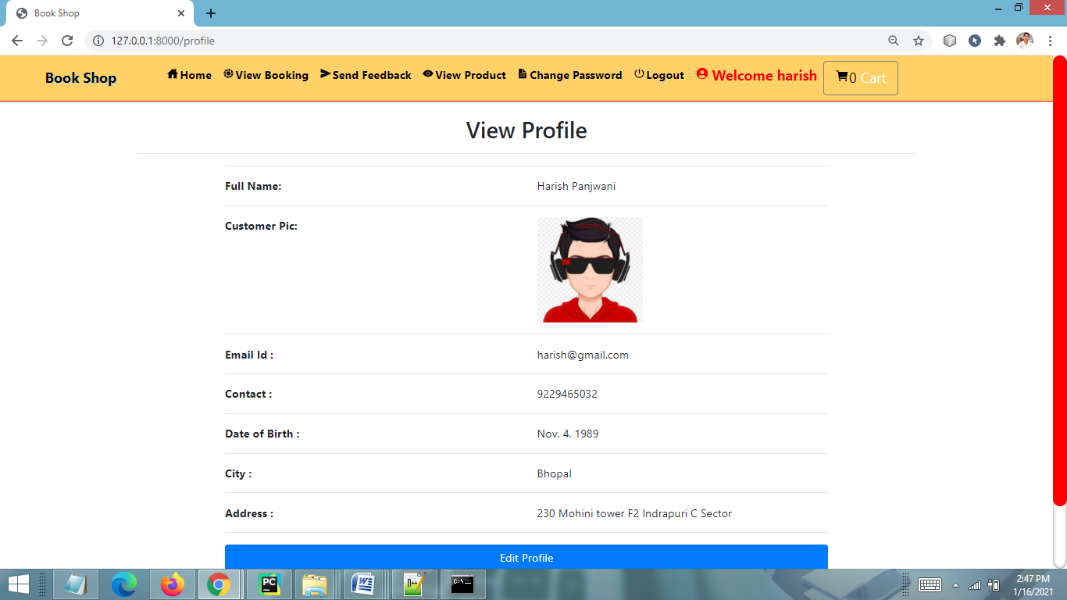
USER PROFILE PAGE

Slide 32
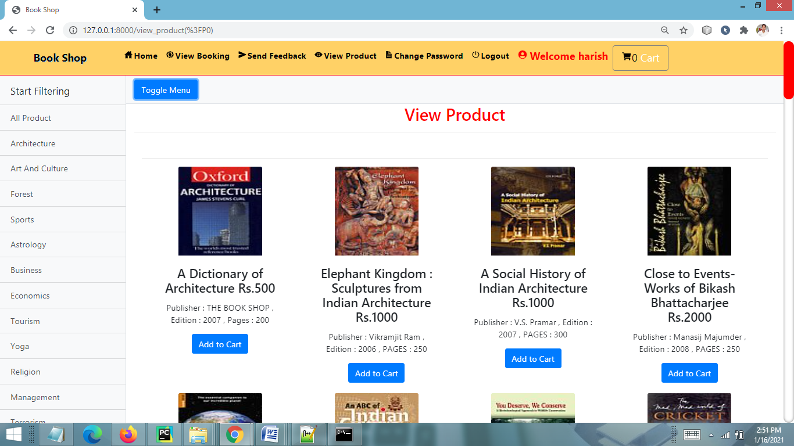
VIEW PRODUCT PAGE

Slide 33
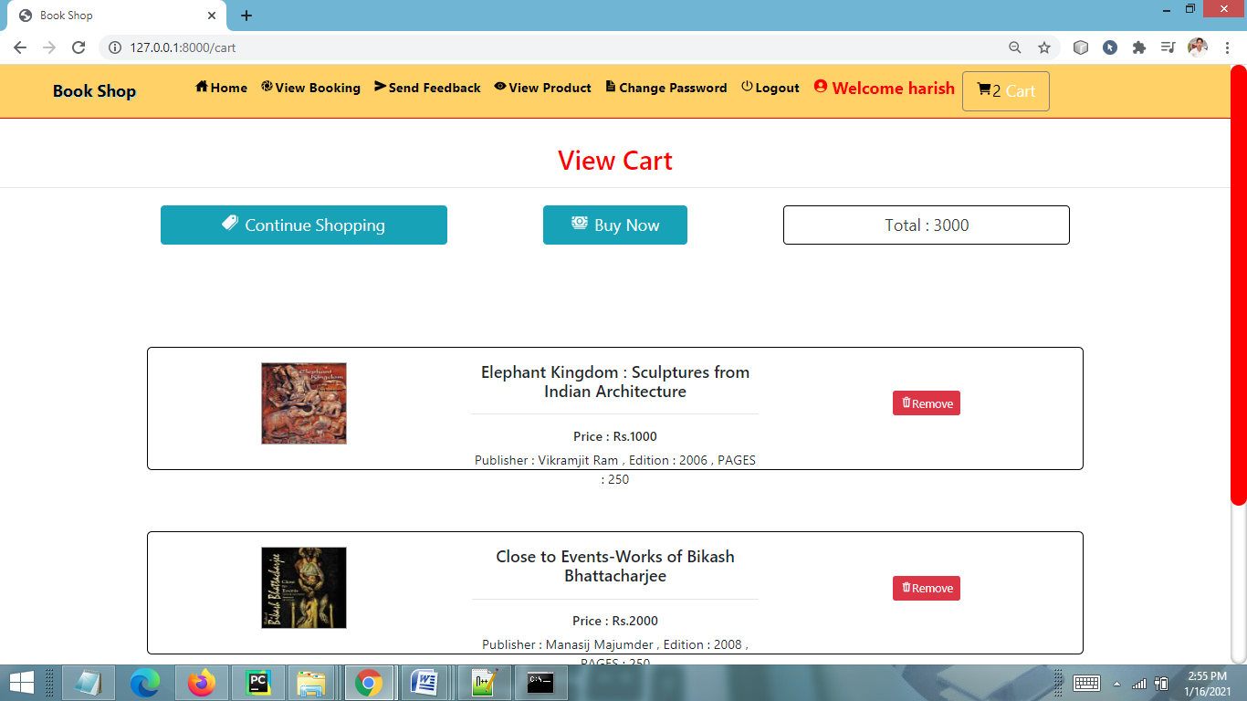
VIEW CART PAGE

Slide 34
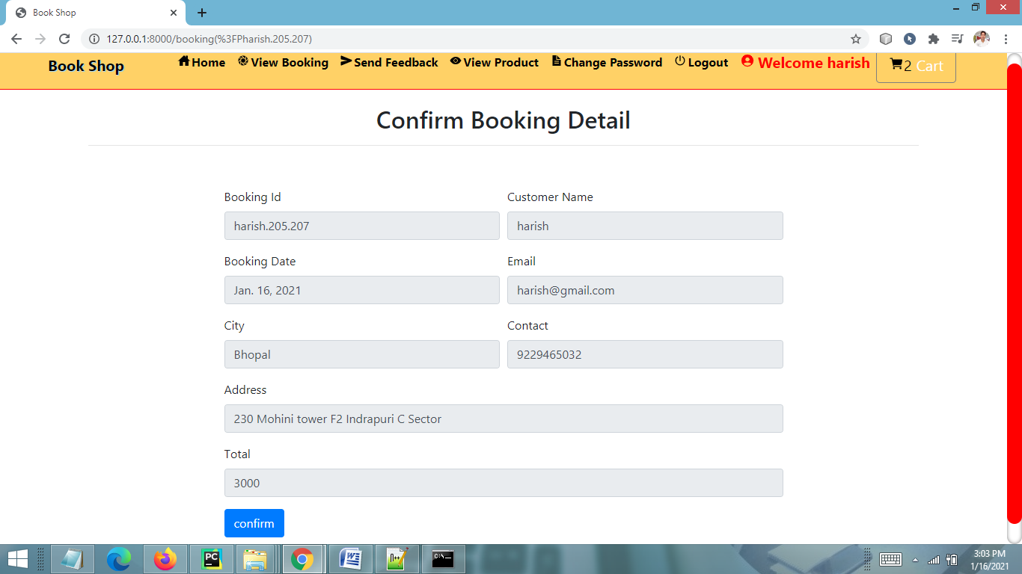
CONFIRM BOOKING PAGE

Slide 35
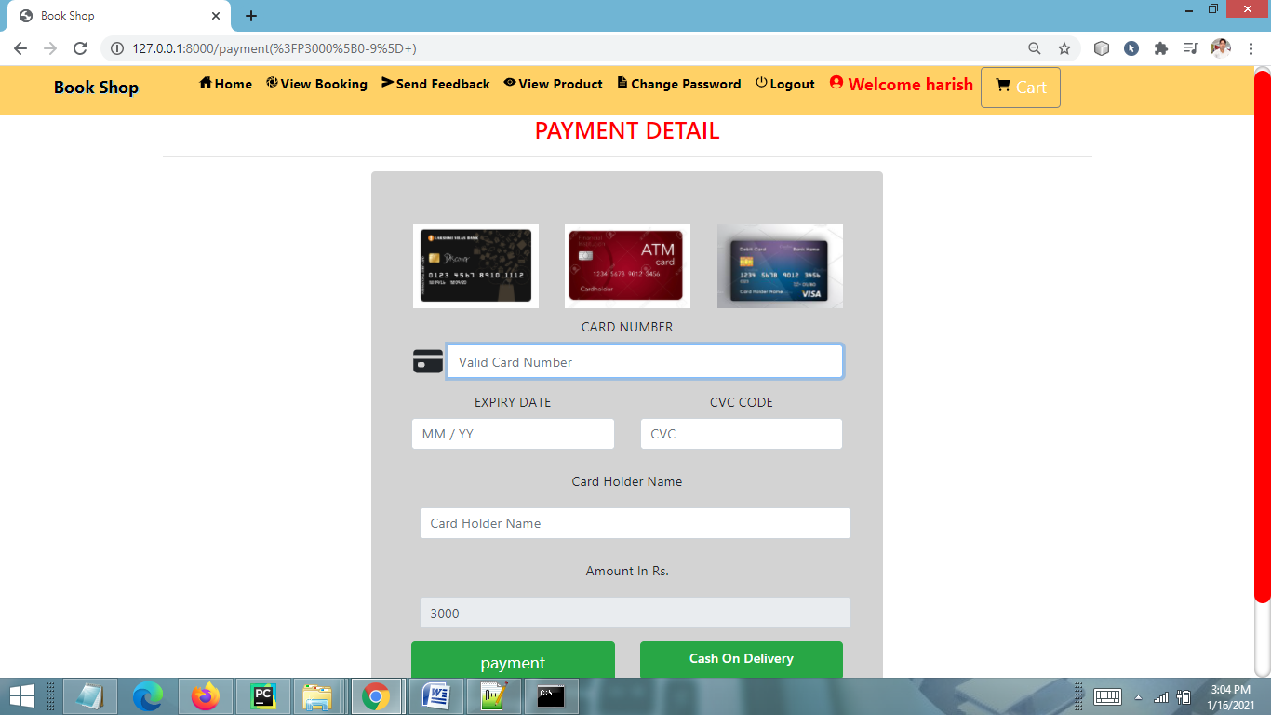
PAYMENT PAGE

Slide 36
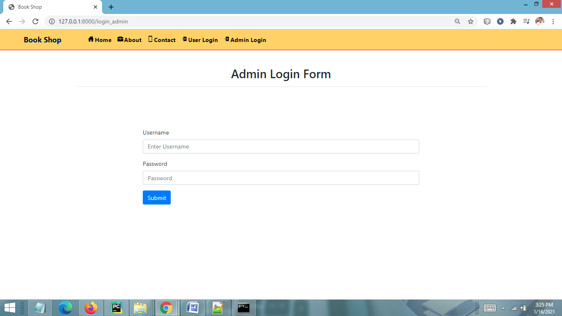
ADMIN LOGIN PAGE

Slide 37
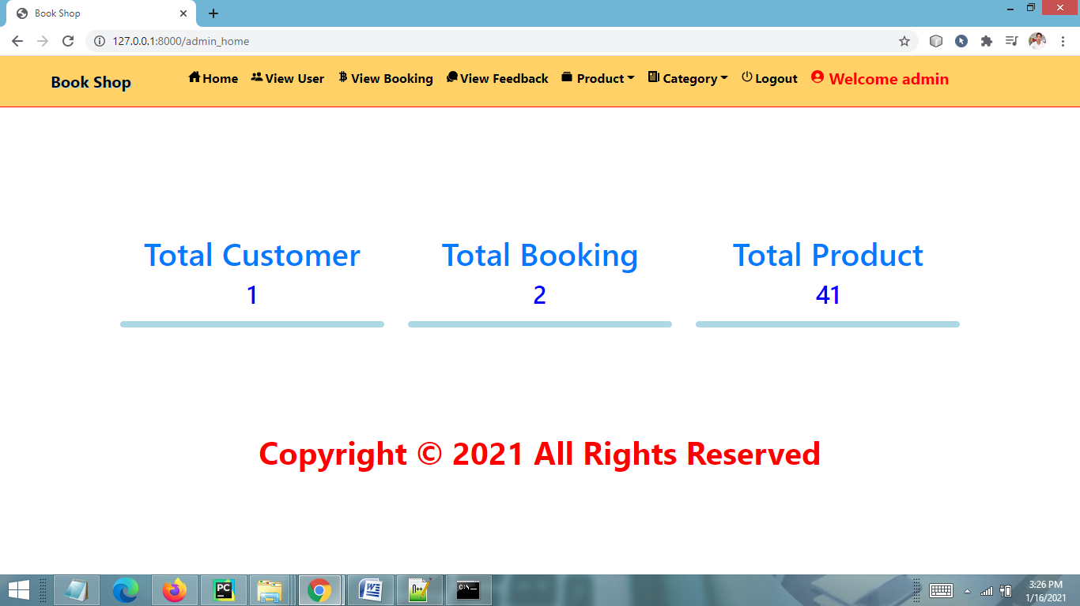
ADMIN HOME PAGE

Slide 38
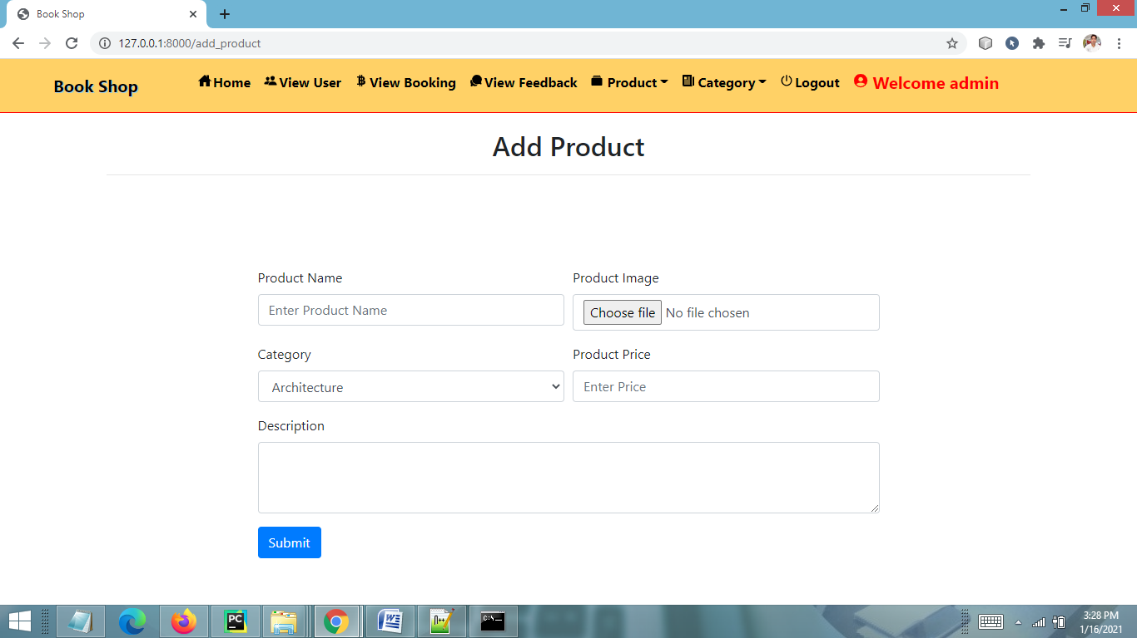
ADD PRODUCT PAGE

Slide 39
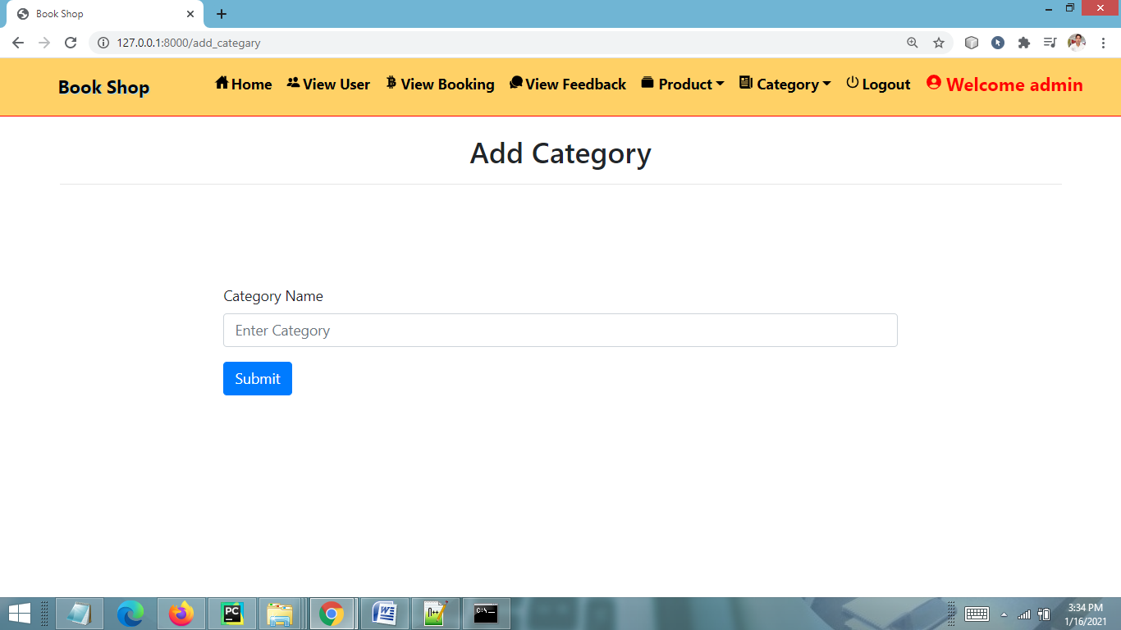
ADD PRODUCT CATEGORY PAGE

Slide 40
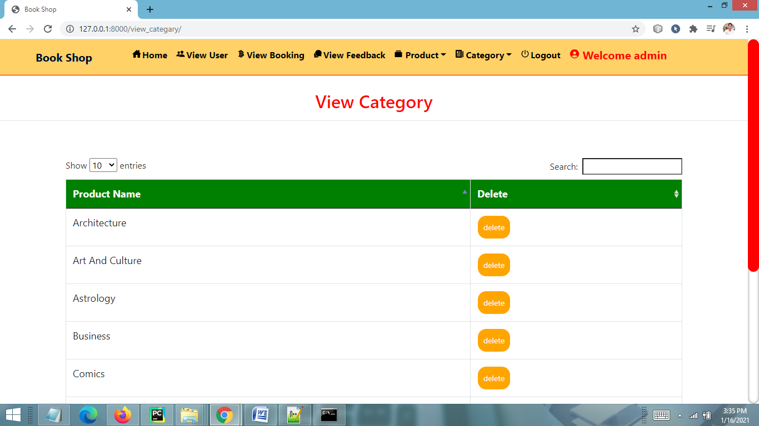
VIEW CATEGORY PAGE

Slide 41
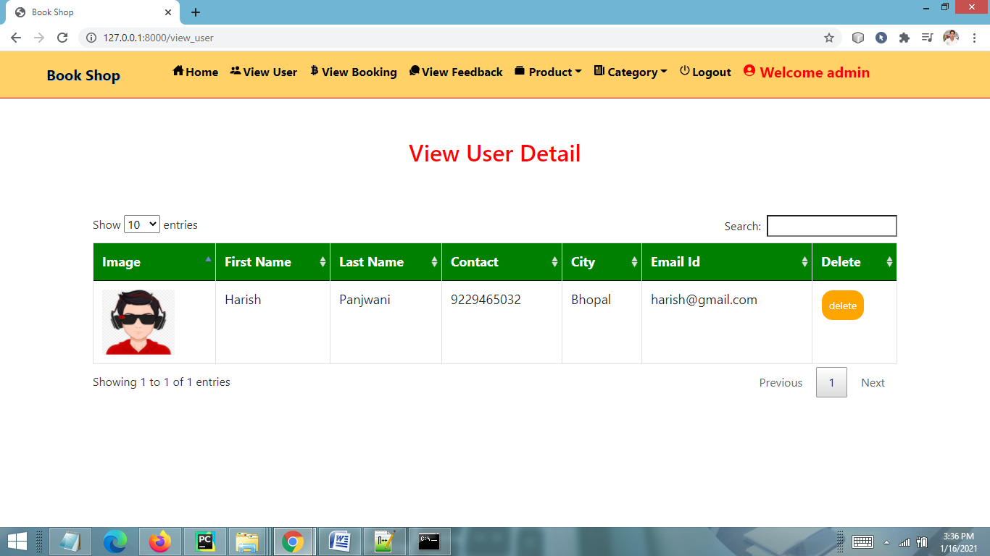
VIEW ALL REG. USERS PAGE

Slide 42
CONCLUSION & FUTURE SCOPE
FUTURE SCOPE
This web application involves almost all the features of the online shopping. The future implementation will be online help for the customers and chatting with website administrator.
CONCLUSION
The project entitled “Online Book Shop” is developed using HTML , CSS and JS as front end and Python language and sqlite database in back end to computerize the process of online shopping of books. This project covers only the basic features required.

Slide 43
BIBLIOGRAPHY
FOR PYTHON INSTALLATION
https://www.python.org
FOR HTML , CSS ANF PYTHON BASICS
www.w3schools.com
www.javatpoint.com
https://www.geeksforgeeks.org/python-django/
REFERENCE BOOKS
Two scoops of Django for 1.11 by Daniel Greenfeld’s and Audrey Greenfield
Lightweight Django by Elman and Mark Lavin

Slide 44
THANKYOU

